Slide 1
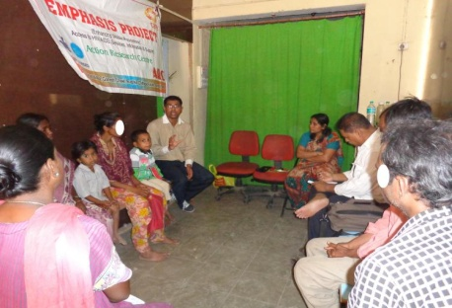
Migrant people Living with HIV (PLHIV) from Nepal and Bangladesh and working in India successfully linked to access ART services in India Authors: Sandeep Gaikwad, Nabesh Bohidar, Purna Kumal, Prakash Pandey, Prakash Madai Affiliations : CARE India and Action Research Centre
Introduction:
Mumbai is one of the intervention sites of EMPAHSIS and also remains as one of the major transmission centres for HIV over the last two decades. Although there is no valid data on legal and illegal migration respectively from Nepal and Bangladesh to Mumbai, yet working with the cross border migrants who remain a shadow population, reveal that there is fairly a large number and many are living with HIV.
In fear of arrest, stigma and lack of information, cross border migrants are reluctant to avail the services and stand threatened due to lack of regular ART intake. Through EMPHASIS project migrant PLHIV from other countries have been linked successfully to ART and all other HIV related services, free of cost under the government programme.
The PLHIV support visit is conducted at every months with PLHIV. It is providing opportunities to come together and share their life story, ordeal and difficulties in their life which make other PLHIV feel sympathetic towards each other and they can feel that they are not only to have such pain in their life. Support visit for PLHIV also imparts wherein awareness about HIV and STI are given to PWHIV and Project goals and objectives are also shared. On of the major focus is given on capacity building on n HIV prevention, STI etc. Importance of ART regimen, diet food, exercise and CD4 test shared to PLHIV.
During the outreach work, ORW explores for potential PLHIV who are taking ART from their origin country and want to start getting ART from destination country itself. A team from origin country is communicated to send transfer letter which is prerequisite to start ART at destination. After getting transfer letter from the team, team at the destination approaches to ART centre in the vicinity and links PLHIV to start ART from desired ART centre in India. Likewise, any PLHIV is found out taking ART from origin country but staying in India and want to get ART from India. Then a team is approached in India and details are shared with the team in India and transfer letter is sent to team in India and ART linkage is made
Project and Activities:
This has been a major achievement in EMPHASIS addressing a major service needs, advocacy issues and rights of the people in linking across the borders successfully. The model of cross border linkage using the migrant information centres and peer educators from the community across the countries at source, transit and destination shows a ways of achieving the goals of zeroing on new infections, AIDS related death and stigma.
Cross Border PLHIV ART linkages Details
Type of Impact population | Cross Border migrnats PLHIV | Cross Border PLHIV linked to ART centre
Nepali migrants PLHIV | 102 | 34
Bangla speaking migrant PLHIV | 40 | 7
Total | 142 | 41
PLHIV support visit
Conclusions:
EMPHASIS has been able to link 33 Nepali Cross Border PLHIV and 7 Bangladeshi Cross Border PLHIV to ART centres and they have been taking ART successfully.
Migrants across borders remain vulnerable to HIV due limited accessibility to prevention, care support and treatment services, EMPHASIS showcases the process of how to they can be linked to government and other services. EMPHASIS works with the governments at source and destination to come together to address the linkages and develop mutual information sharing and service linkages, proving thereby that borders may restrict nationalities but does not restrict response to HIV.
Data source: EMPHASIS project from Emphasis project from April 2011-September 2013.

